Slide 1

Core Spring interview Q & A
By Sanjay Degaonkar

Slide 2
Practical material
https://github.com/sanjaydegaonkar/spring

Slide 3
When the container is started?
When we create the object of ApplicationContext, container is started.

Slide 4
What is a Spring bean configuration file?
A Spring bean configuration file is an XML file. Convention is "applicationContext.xml"

Slide 5
How to create object of ApplicationContext?
ApplicationContext context = new ClassPathXmlApplicationContext("applicationContext.xml");

Slide 6
Who creates object? When the object is created ?
Container creates object.
ApplicationContext applicationContext = new ClassPathXmlApplicationContext("applicationContext.xml");
Employee employee = (Employee)applicationContext.getBean("employee");

Slide 7
What is difference between BeanFactory and ApplicationContext?
Lazy loading (loads beans on demand)
Support two scopes only : singleton and prototype
No support for internationalization and annotation based dependency
Used to create small app
Early loading ( loads beans at start up )
Supports all scopes
supports Internationalization, Annotation based dependency, event handling, AOP.
used to create enterprise app

Slide 8
How to inject the object?
Setter injection
Constructor injection
Constructor injection example : Thread(Runnable target)

Slide 9
Singleton scope vs prototype scope
single object instance per Spring IoC container
Use case : single Bank object
Returns a new bean instance each time you request (getBean()) or ref(attribute ref)
Use case : In banking for every customer creating a new object

Slide 10
Is singleton scope follows singleton design pattern ?
No
Singleton design pattern says – single object per JVM
Where as singleton scope says – single object per container

Slide 11
Are Singleton Beans Thread-Safe?
No, singleton beans are not thread-safe. Thread safety depends only on the bean implementation itself.

Slide 12
What are different bean scopes in Spring?
singleton – Scopes a single bean definition to a single object instance per Spring IoC container.
prototype – Returns a new bean instance each time you request or ref.
request – Returns a single bean instance per HTTP request.
session – Returns a single bean instance per HTTP session.
globalSession – Returns a single bean instance per global HTTP session.(Portlet applications)

Slide 13
Life cycle methods for initialization and destruction
InitializingBean, DisposableBean
POJO style
JSR annotations
AbstractApplicationContext applicationContext = new ClassPathXmlApplicationContext("applicationContext.xml");
applicationContext.registerShutdownHook();

Slide 14
How can you configure Spring in your application?
XML based configuration (applicationContext.xml)
Java based configuration (@Configuration, @Bean)
Annotation based configuration (@Component, @Service, @Repository, @Controller)

Slide 15
What is inversion of control(IOC)?
In the traditional programming style, developers write code to instantiate dependent objects.
Giving the control of object instantiation from developer to the IOC container is "Inversion of Control“
Dependency Injection (DI) is a design pattern used to implement IoC.

Slide 16
Dependency Injection (DI)
By DI, the responsibility of creating objects is shifted from our application code to the Spring container.
It promotes loose coupling, reusability, testability and maintainability.

Slide 17
What is factory pattern ?
Problem : using new operator we create the object. This approach is fine for small programs but not for large scale enterprise applications.
Factory pattern can be called as a tool to implement DI
BeanFactory and ApplicationContext are factory interfaces

Slide 18
What is autowiring ?
Inject the object dependency implicitly.
It internally uses setter or constructor injection.
Autowiring can't be used to inject primitive and string values.

Slide 19
What is @Qualifier annotation in Spring?
You can have more than one bean of same type in your XML configuration but you want to autowire only one of them.
E.g. Employee has Address.
You have two addresses address1 and address2
@Qualifier removes confusion created by @Autowired by declaring exactly which bean is to autowired.

Slide 20
@Component @controller @service @repository
We always follow layered architecture
@Component can be used in any layer
@Controller is used in the controller layer
@Service is used in the business layer
@Repository is used in the DAO layer

Slide 21
Can We Have Multiple Spring Configuration Files in One Project?
Yes, recommended in large projects.
Maintenance
Modularity

Slide 22
Design patterns covered in Spring Framework
Factory Pattern: Bean Factory , ApplicationContext
Prototype Pattern: Prototype-scoped beans
Adapter Pattern: Spring Web and Spring MVC
Proxy Pattern: Spring Aspect Oriented Programming support
Template Method Pattern: JdbcTemplate, HibernateTemplate, etc.
Front Controller: Spring MVC DispatcherServlet
Data Access Object: Spring DAO support
Model View Controller: Spring MVC

Slide 23
Who developed spring framework ?
Rod Johnson
Spring – Next version of Winter(EJB)

Slide 24
Spring Features?
Predefined Templates (e.g JdbcTemplate)
Loose coupling (DI)
Easy to test (Spring framework doesn’t require any server)
Lightweight
Fast Development (Framework of Frameworks)
Powerful abstraction (JMS, JPA)
Declarative support (Caching, Validation, Transaction)

Slide 25
Which version are you aware?
2.5 (annotation support)
3.0 (great use of Java5 improvements and also provided support to JEE6)
4.0 (first version to provide full support to Java 8)
5.0 (supports Java 9)

Slide 26
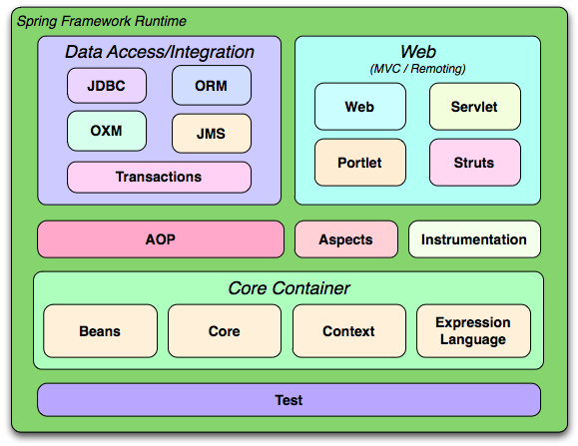
How many modules?

Slide 27
Thank you ☺

